Slide 1



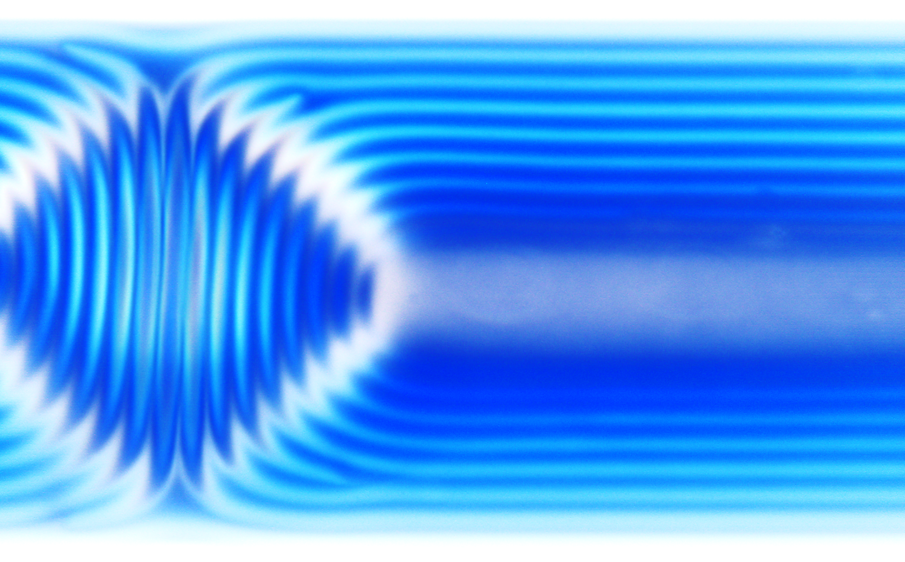
Temperature-dependence of the static contact angle
A universal scaling law covering ideal cases, roughness effects and the transition to total wetting
Benoît Duchemin, Guillaume Cazaux, Moussa Gomina, Joël Bréard
Laboratoire Ondes et Milieux Complexes Normandie Université, CNRS
LE HAVRE, FRANCE
ACS spring 2021 national meeting

Slide 2
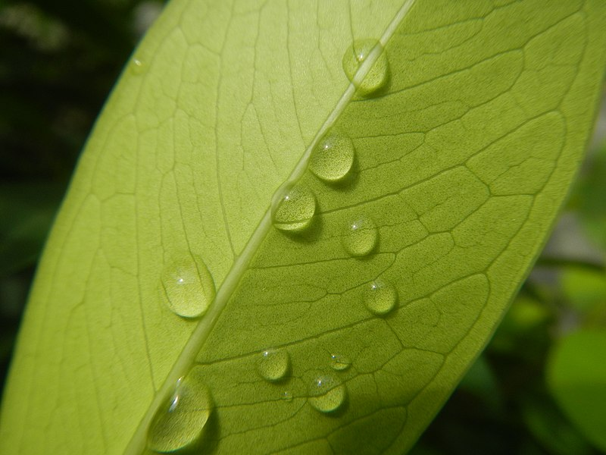
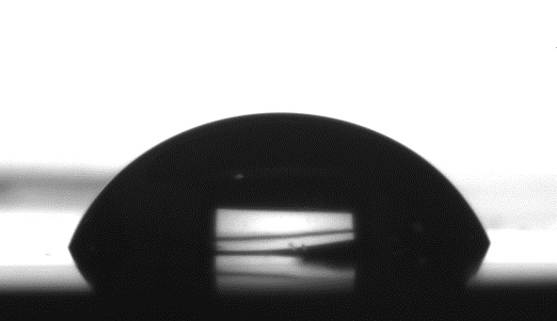

Static contact angles are ubiquitous
A liquid standing on a solid surface
Importance in many technological fields: coatings, composites, kitchenware, automotive industry, etc.
Bo << 1
Duchemin, 2021

Slide 3
Effect of temperature on contact angles
The case of dynamic contact angles is « covered » by two main theories
The molecular kinetic theory (Blake and Haynes, 1969)
The hydrodynamic approaches
Tanner (1979)-De Gennes (1986)
Cox (1962)-Voinov (1976)
Pucci, M.F., Duchemin, B., Gomina, M., Bréard, J., 2020. Dynamic Wetting of Molten Polymers on Cellulosic Substrates: Model Prediction for Total and Partial Wetting. Front. Mater. 7, 143.
Pucci, M.F., Duchemin, B., Gomina, M., Bréard, J., 2018. Temperature effect on dynamic wetting of cellulosic substrates by molten polymers for composite processing. Composites Part A: Applied Science and Manufacturing 114, 307–315.
Duchemin, 2021

Slide 4
Effect of temperature on contact angles
The case of dynamic contact angles is « covered » by two main theories
The molecular kinetic theory (Blake and Haynes, 1969)
The hydrodynamic approaches
Tanner (1979)-De Gennes (1986)
Cox (1962)-Voinov (1976)
Pucci, M.F., Duchemin, B., Gomina, M., Bréard, J., 2020. Dynamic Wetting of Molten Polymers on Cellulosic Substrates: Model Prediction for Total and Partial Wetting. Front. Mater. 7, 143.
Pucci, M.F., Duchemin, B., Gomina, M., Bréard, J., 2018. Temperature effect on dynamic wetting of cellulosic substrates by molten polymers for composite processing. Composites Part A: Applied Science and Manufacturing 114, 307–315.
Duchemin, 2021

Slide 5
Effect of temperature on static contact angles
The case of static contact angles is less clear :
Θ= a.T + b (De Ruijter, 1988; Petke, 1969)
cos(Θ)= a.T + b (Gribanova, 1992; Zisman, 1964)
cos(Θ)= a.T^{x} +b (Bernardin, 1997; Adamson, 1973)
One case of ↗ θ with ↗ T (Berim, 2009)
The question of a universal and predictive model remains…
Duchemin, 2021

Slide 6
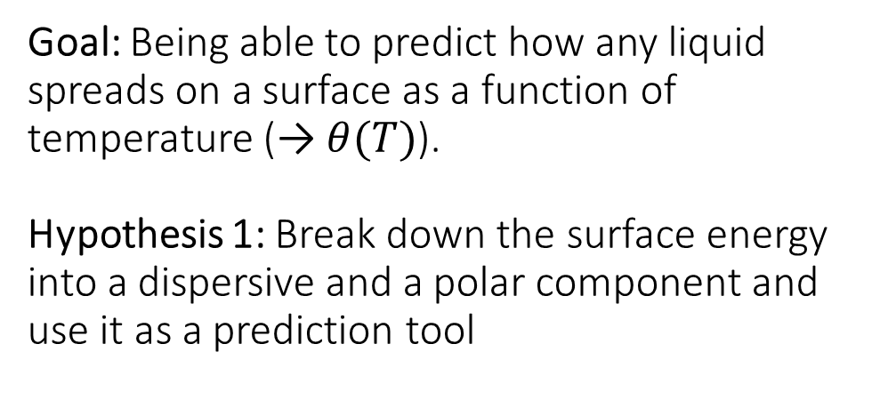
Goal: Being able to predict how any liquid spreads on a surface as a function of temperature (→ $θ(T)$).
Hypothesis 1: Break down the surface energy into a dispersive and a polar component and use it as a prediction tool
Method:
$γ_{liquid}$(T)
𝛾_𝑙𝑖𝑞𝑢𝑖𝑑(T)
Pendant drop on several liquids
$γ_{PTFE}^{LW}$(T)
𝛾_𝑃𝑇𝐹𝐸^𝐿𝑊(T)
Contact angle with an apolar liquid: CH₂I₂
$γ_{liquid}^{LW}$(T)
𝛾_𝑙𝑖𝑞𝑢𝑖𝑑^𝐿𝑊(T)
$γ_{solids}^{LW}$(T) and
$γ_{solids}^{AB}$(T)
(Fowkes or Owens-Wendt methods)
𝛾_𝑠𝑜𝑙𝑖𝑑𝑠^𝐿𝑊(T) and
𝛾_𝑠𝑜𝑙𝑖𝑑𝑠^𝐴𝐵(T)
(Fowkes or Owens-Wendt methods)
Contact angle with several liquids
Van Oss, Good and Chaudury (1986, 1988):
= γ^{LW} + γ^{AB}
The Berthelot hypothesis when at least one component is apolar:
γ_{solid-liquid} = γ_{solid} + γ_{liquid} – 2.( γ_{solid}^{LW}. γ_{liquid}^{LW})^{½}
Which mixed with Young’s equation and neglecting the
spreading pressure gives:
γ_{liquid.}(1 + cosθ_{s}) = 2.( γ_{solid}^{LW}. γ_{liquid}^{LW})^{½}
Duchemin, 2021

Slide 7
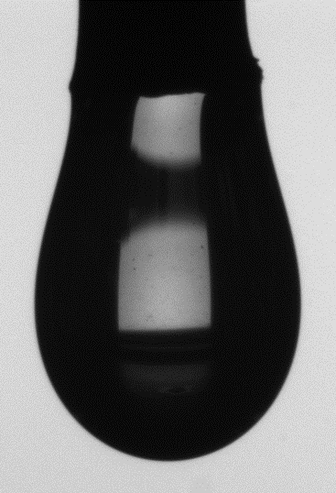
Eötvös (1886):
γ_{l} .V_{m}^{2/3} = κ.(T₀ – T)
Method:
$γ_{liquid}$(T)
𝛾_𝑙𝑖𝑞𝑢𝑖𝑑(T)
Pendant drop on several liquids
$γ_{PTFE}^{LW}$(T)
𝛾_𝑃𝑇𝐹𝐸^𝐿𝑊(T)
Contact angle with an apolar liquid: CH₂I₂
$γ_{liquid}^{LW}$(T)
𝛾_𝑙𝑖𝑞𝑢𝑖𝑑^𝐿𝑊(T)
$γ_{solids}^{LW}$(T) and
$γ_{solids}^{AB}$(T)
(Fowkes or Owens-Wendt methods)
𝛾_𝑠𝑜𝑙𝑖𝑑𝑠^𝐿𝑊(T) and
𝛾_𝑠𝑜𝑙𝑖𝑑𝑠^𝐴𝐵(T)
(Fowkes or Owens-Wendt methods)
Contact angle with several liquids
Surface tensions of water (), glycerol (), formamide (), methylene iodide (), ethylene carbonate () and methyl benzoate () at various temperatures.
Duchemin, 2021

Slide 8
Method:
$γ_{liquid}$(T)
𝛾_𝑙𝑖𝑞𝑢𝑖𝑑(T)
Pendant drop on several liquids
$γ_{PTFE}^{LW}$(T)
𝛾_𝑃𝑇𝐹𝐸^𝐿𝑊(T)
Contact angle with an apolar liquid: CH₂I₂
$γ_{liquid}^{LW}$(T)
𝛾_𝑙𝑖𝑞𝑢𝑖𝑑^𝐿𝑊(T)
$γ_{solids}^{LW}$(T) and
$γ_{solids}^{AB}$(T)
(Fowkes or Owens-Wendt methods)
𝛾_𝑠𝑜𝑙𝑖𝑑𝑠^𝐿𝑊(T) and
𝛾_𝑠𝑜𝑙𝑖𝑑𝑠^𝐴𝐵(T)
(Fowkes or Owens-Wendt methods)
Contact angle with several liquids
Duchemin, 2021

Slide 9
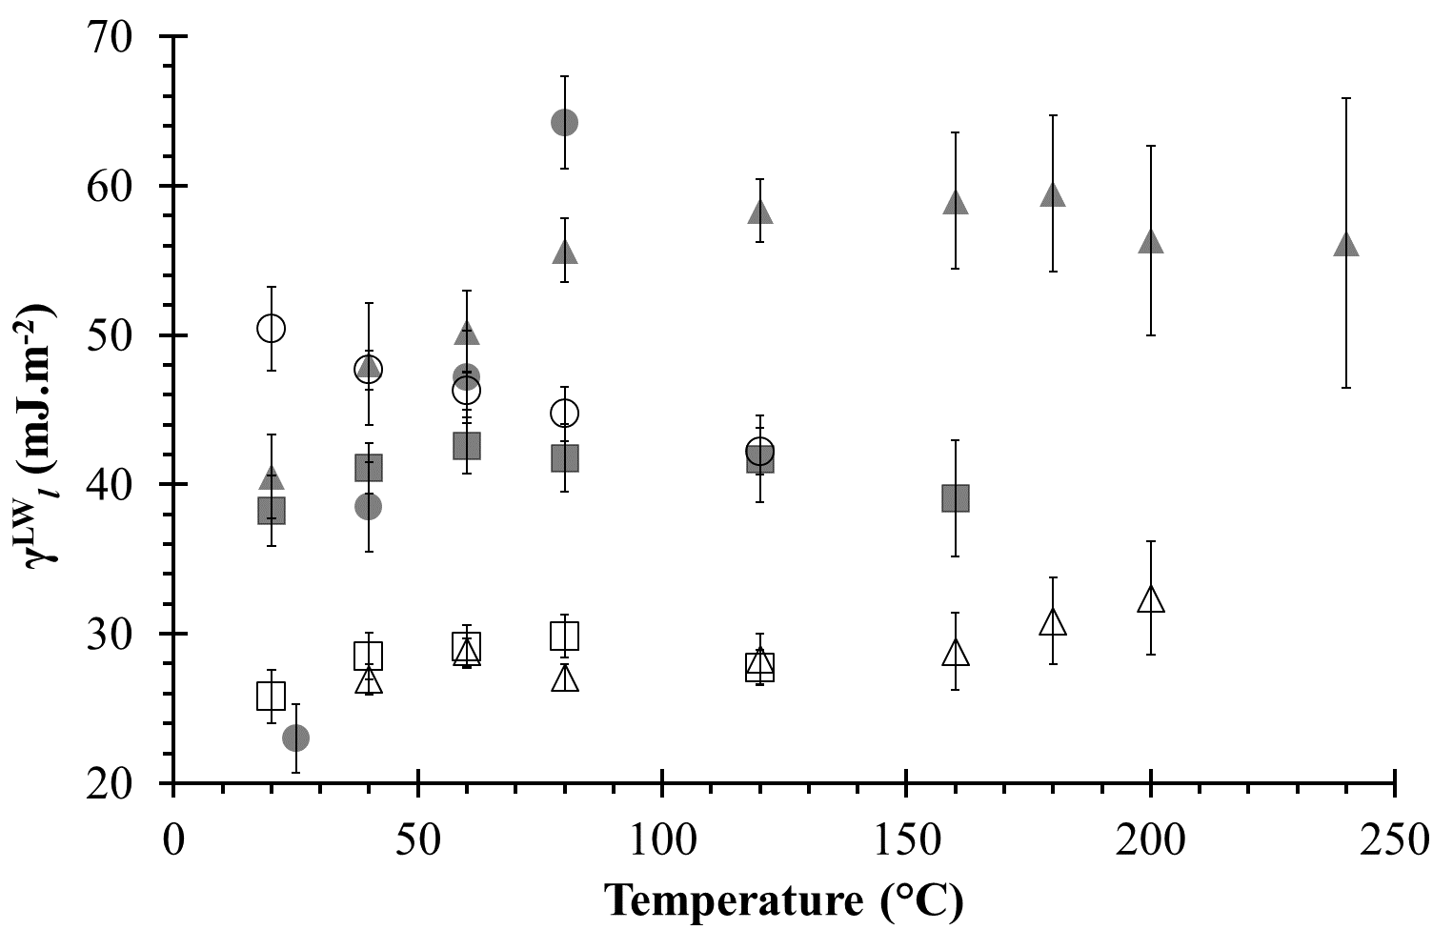
Method:
$γ_{liquid}$(T)
𝛾_𝑙𝑖𝑞𝑢𝑖𝑑(T)
Pendant drop on several liquids
$γ_{PTFE}^{LW}$(T)
𝛾_𝑃𝑇𝐹𝐸^𝐿𝑊(T)
Contact angle with an apolar liquid: CH₂I₂
$γ_{liquid}^{LW}$(T)
𝛾_𝑙𝑖𝑞𝑢𝑖𝑑^𝐿𝑊(T)
$γ_{solids}^{LW}$(T) and
$γ_{solids}^{AB}$(T)
(Fowkes or Owens-Wendt methods)
𝛾_𝑠𝑜𝑙𝑖𝑑𝑠^𝐿𝑊(T) and
𝛾_𝑠𝑜𝑙𝑖𝑑𝑠^𝐴𝐵(T)
(Fowkes or Owens-Wendt methods)
Contact angle with several liquids
Calculated dispersive components of the surface tensions of water (), glycerol (), formamide (), methylene iodide (), ethylene carbonate () and methyl benzoate () at various temperatures. All error bars were calculated by propagation of uncertainty.
Duchemin, 2021

Slide 10
Method:
$γ_{liquid}$(T)
𝛾_𝑙𝑖𝑞𝑢𝑖𝑑(T)
Pendant drop on several liquids
$γ_{PTFE}^{LW}$(T)
𝛾_𝑃𝑇𝐹𝐸^𝐿𝑊(T)
Contact angle with an apolar liquid: CH₂I₂
$γ_{liquid}^{LW}$(T)
𝛾_𝑙𝑖𝑞𝑢𝑖𝑑^𝐿𝑊(T)
$γ_{solids}^{LW}$(T) and
$γ_{solids}^{AB}$(T)
(Fowkes or Owens-Wendt methods)
𝛾_𝑠𝑜𝑙𝑖𝑑𝑠^𝐿𝑊(T) and
𝛾_𝑠𝑜𝑙𝑖𝑑𝑠^𝐴𝐵(T)
(Fowkes or Owens-Wendt methods)
Contact angle with several liquids
Calculated dispersive components of the surface tensions of water (), glycerol (), formamide (), methylene iodide (), ethylene carbonate () and methyl benzoate () at various temperatures. All error bars were calculated by propagation of uncertainty.
Duchemin, 2021

Slide 11
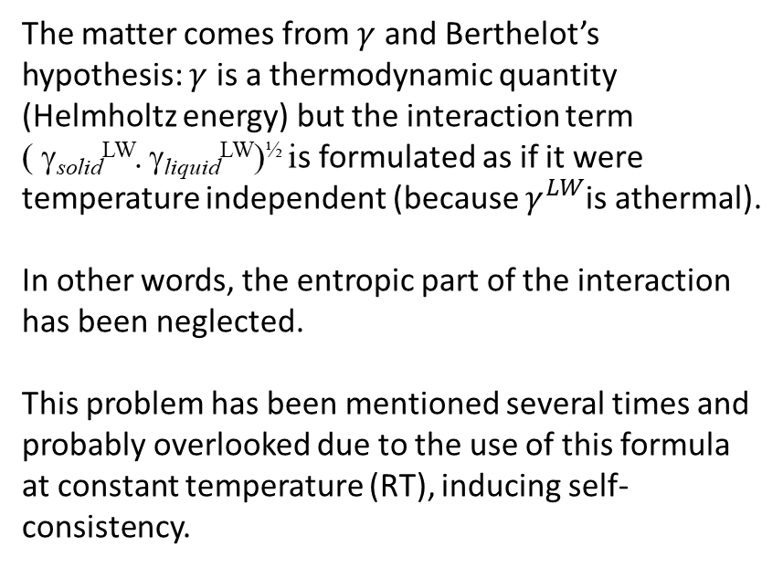
Conclusion:
Method:
The matter comes from $γ$ and Berthelot’s hypothesis: $γ$ is a thermodynamic quantity (Helmholtz energy) but the interaction term
( γ_{solid}^{LW}. γ_{liquid}^{LW})^{½} is formulated as if it were temperature independent (because $γ^{LW}$is athermal).
In other words, the entropic part of the interaction has been neglected.
This problem has been mentioned several times and probably overlooked due to the use of this formula at constant temperature (RT), inducing self-consistency.
$γ_{liquid}$(T)
𝛾_𝑙𝑖𝑞𝑢𝑖𝑑(T)
Pendant drop on several liquids
$γ_{PTFE}^{LW}$(T)
𝛾_𝑃𝑇𝐹𝐸^𝐿𝑊(T)
Contact angle with an apolar liquid: CH₂I₂
$γ_{liquid}^{LW}$(T)
𝛾_𝑙𝑖𝑞𝑢𝑖𝑑^𝐿𝑊(T)
$γ_{solids}^{LW}$(T) and
$γ_{solids}^{AB}$(T)
(Fowkes or Owens-Wendt methods)
𝛾_𝑠𝑜𝑙𝑖𝑑𝑠^𝐿𝑊(T) and
𝛾_𝑠𝑜𝑙𝑖𝑑𝑠^𝐴𝐵(T)
(Fowkes or Owens-Wendt methods)
Contact angle with several liquids
Douillard, J.M., 1997. Concerning the Thermodynamic Consistency of the “Surface Tension Components” Equations. Journal of Colloid and Interface Science 188, 511–515.
Lyklema, J., 1999. The surface tension of pure liquids: Thermodynamic components and corresponding states. Colloids and Surfaces A: Physicochemical and Engineering Aspects 156, 413–421.
Weber, C., Stanjek, H., 2014. Energetic and entropic contributions to the work of adhesion in two-component, three-phase solid–liquid–vapour systems. Colloids and Surfaces A: Physicochemical and Engineering Aspects 441, 331–339.
Duchemin, 2021

Slide 12
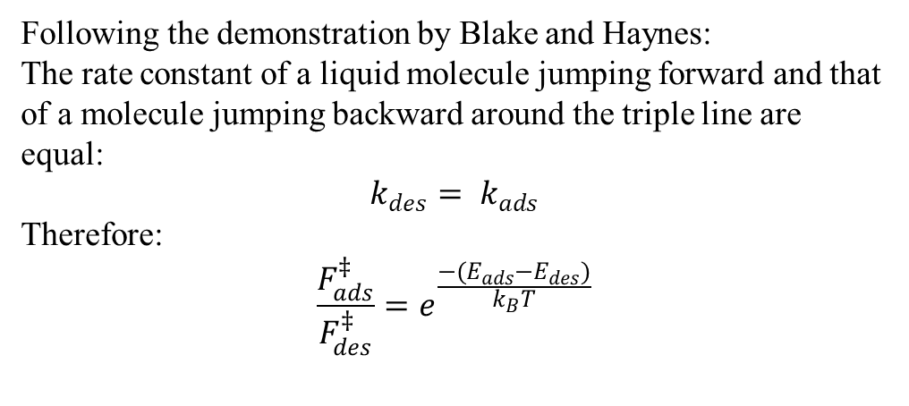
A physical description based on the thermocapillary amplitude
Following the demonstration by Blake and Haynes:
The rate constant of a liquid molecule jumping forward and that of a molecule jumping backward around the triple line are equal:
$$k_{des}= k_{ads}$$
Therefore:
$$\frac{F_{ads}^{‡}}{F_{des}^{‡}}=e^{\frac{−(E_{ads}−E_{des})}{k_{B}T}}$$
Activation free energy
Partition function ratio (similar to Crooks definition of entropy: the probability of undergoing a process divided by the probability of undergoing the reverse process)
Duchemin, 2021

Slide 13
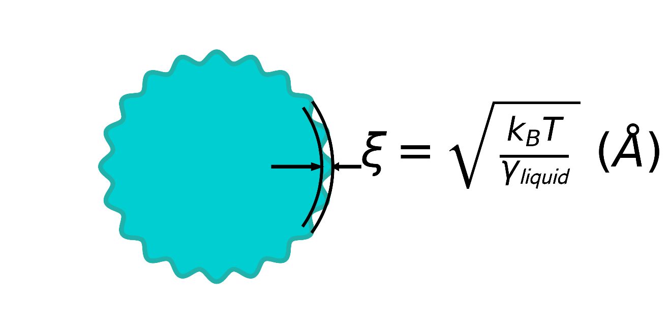

A physical description based on the thermocapillary amplitude
Following the demonstration by Blake and Haynes:
The rate constant of a liquid molecule jumping forward and that of a molecule jumping backward around the triple line are equal:
$$k_{des}= k_{ads}$$
Therefore:
$$\frac{F_{ads}^{‡}}{F_{des}^{‡}}=e^{\frac{−(E_{ads}−E_{des})}{k_{B}T}}$$
The surface of liquids bears a certain roughness due to the existence of thermally excited capillary waves. The scale of the problem is the thermal length ξ:
Hypothesis 2-1: the amplitude of the jumps is equal to ξ:
$$E_{ads}−E_{des}=−S.ξ^{2}$$
Where S is the spreading parameter:
$$S= γ_{sv}−(γ_{sl}+γ_{l})$$
$$S= γ_{l}(\cos{θ_{Y}}−1)$$
Activation free energy
Partition function ratio (similar to Crooks definition of entropy: the probability of undergoing a process divided by the probability of undergoing the reverse process)
Duchemin, 2021
Notes:
D. Belardinelli, M. Sbragaglia, M. Gross, B. Andreotti, Thermal fluctuations of an
interface near a contact line, Phys. Rev. E 94 (5) (2016), https://doi.org/
10.1103/PhysRevE.94.052803 052803.

Slide 14

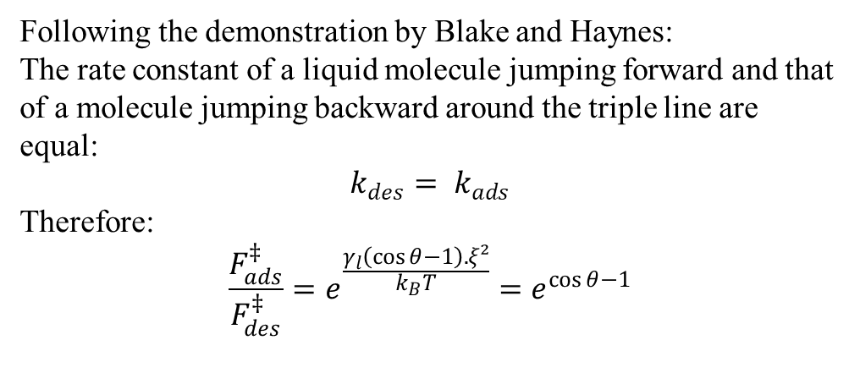
A physical description based on the thermocapillary amplitude
Following the demonstration by Blake and Haynes:
The rate constant of a liquid molecule jumping forward and that of a molecule jumping backward around the triple line are equal:
$$k_{des}= k_{ads}$$
Therefore:
$$\frac{F_{ads}^{‡}}{F_{des}^{‡}}=e^{\frac{γ_{l}\left(\cos{θ}−1\right).ξ²}{k_{B}T}}=e^{\cos{θ}−1}$$
Thermal length ξ:
$$E_{ads}−E_{des}={−γ}_{l}\left(\cos{θ_{Y}}−1\right).ξ^{2}$$
Activation free energy
Partition function ratio (similar to Crooks definition of entropy: the probability of undergoing a process divided by the probability of undergoing the reverse process)
Duchemin, 2021

Slide 15
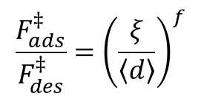
A physical description based on the thermocapillary amplitude
Following the demonstration by Blake and Haynes:
The rate constant of a liquid molecule jumping forward and that of a molecule jumping backward around the triple line are equal:
$$k_{des}= k_{ads}$$
Therefore:
$$\frac{F_{ads}^{‡}}{F_{des}^{‡}}=e^{\frac{γ_{l}\left(\cos{θ}−1\right).ξ²}{k_{B}T}}=e^{\cos{θ}−1}$$
A characteristic distance (< d >) understood as the lateral correlation length between adsorption sites (or finite potential wells) describes the pseudo-periodicity of the surface:
(< d >)
Activation free energy
Partition function ratio (similar to Crooks definition of entropy: the probability of undergoing a process divided by the probability of undergoing the reverse process)
Hypothesis 2-2: The partition function ratio is assumed to be equal to the ratio of capillary wave amplitude divided by this cutoff length, with a fractal dimension:
$$\frac{F_{ads}^{‡}}{F_{des}^{‡}}={\left(\frac{ξ}{〈d〉}\right)}^{f}$$
Duchemin, 2021

Slide 16
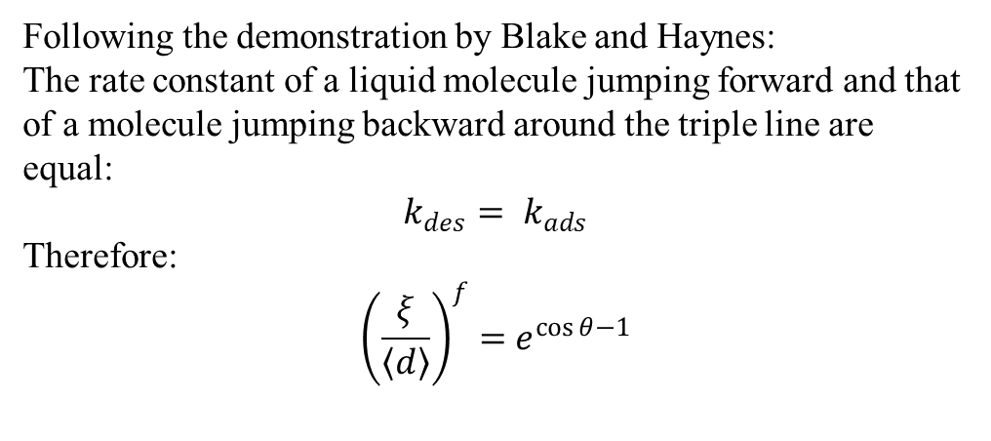
A physical description based on the thermocapillary amplitude
Following the demonstration by Blake and Haynes:
The rate constant of a liquid molecule jumping forward and that of a molecule jumping backward around the triple line are equal:
$$k_{des}= k_{ads}$$
Therefore:
$${\left(\frac{ξ}{〈d〉}\right)}^{f}={ e}^{\cos{θ}−1}$$
A characteristic distance (< d >) understood as the lateral correlation length between adsorption sites (or finite potential wells) describes the pseudo-periodicity of the surface:
(< d >)
When T ↗, ξ ↗.
When ξ = <d>, a thermal transition to total wetting is induced.
Hypothesis 2-2: The partition function ratio is assumed to be equal to the ratio of capillary wave amplitude divided by this cutoff length, with a fractal dimension:
$$\frac{F_{ads}^{‡}}{F_{des}^{‡}}={\left(\frac{ξ}{〈d〉}\right)}^{f}$$
Duchemin, 2021

Slide 17
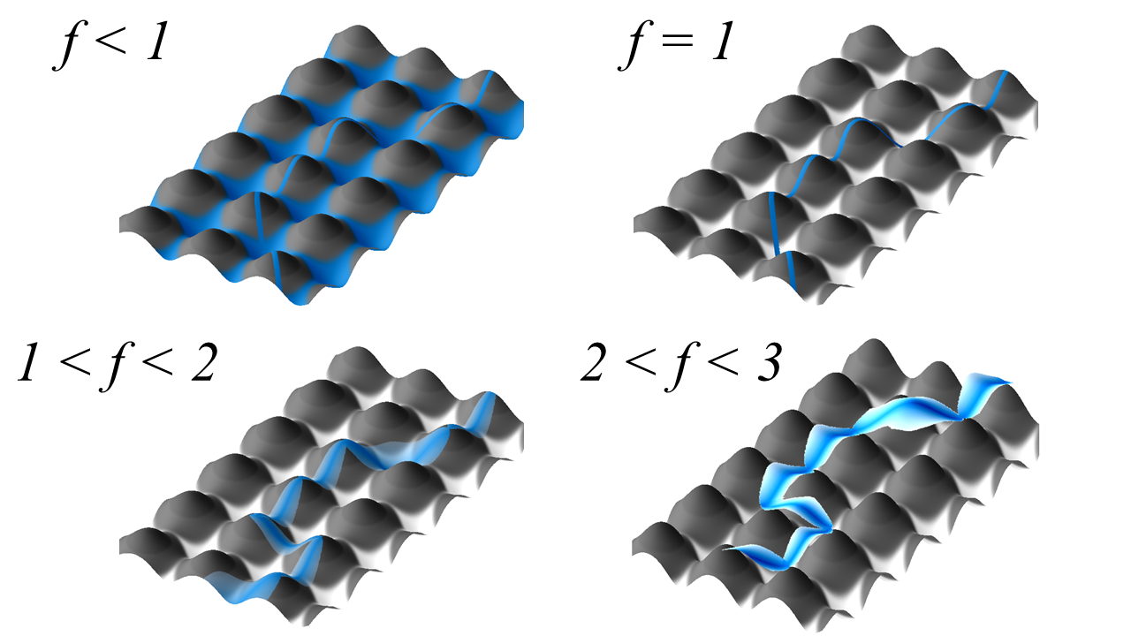

A physical description based on the thermocapillary amplitude
$${\left(\frac{ξ}{〈d〉}\right)}^{f}={ e}^{\cos{θ}−1}$$
Where f is the fractal dimension of the problem:
f = 1 for a triple line jumping straight from well to well
Duchemin, 2021

Slide 18
A physical description based on the thermocapillary amplitude
$${\left(\frac{ξ}{〈d〉}\right)}^{f}={ e}^{\cos{θ}−1}$$
Where f is the fractal dimension of the problem:
f = 1 for a triple line jumping straight from well to well,
1 ≤ f < 2 for a “normal” triple line thermally fluctuating
Duchemin, 2021

Slide 19
A physical description based on the thermocapillary amplitude
$${\left(\frac{ξ}{〈d〉}\right)}^{f}={ e}^{\cos{θ}−1}$$
Where f is the fractal dimension of the problem:
f = 1 for a triple line jumping straight from well to well,
1 ≤ f < 2 for a “normal” triple line thermally fluctuating
2 ≤ f < 3 for a planar triple line, i.e. a Cassie-Baxter state with entrapped gas between the solid surface and the liquid
Duchemin, 2021

Slide 20
A physical description based on the thermocapillary amplitude
$${\left(\frac{ξ}{〈d〉}\right)}^{f}={ e}^{\cos{θ}−1}$$
Where f is the fractal dimension of the problem:
f = 1 for a triple line jumping straight from well to well,
1 ≤ f < 2 for a “normal” triple line thermally fluctuating
2 ≤ f < 3 for a planar triple line, i.e. a Cassie-Baxter state with entrapped gas between the solid surface and the liquid
f < 1 if “hemiwicking” takes place (Wenzel state), thereby decreasing the fraction of triple line in contact with the solid.
Duchemin, 2021

Slide 21
Experimental validation
Six liquids: water, glycerol, methylene iodide, formamide, ethylene carbonate and methyl benzoate.
Six solids: (a) PTFE, (b) glass, (c) brass, (d) stainless steel, (e) alumina and (f) yttria-stabilized zirconia.
Temperature range: between 20 and 240°C.
Duchemin, 2021

Slide 22
Validation (1/3)
Duchemin, 2021

Slide 23
Validation (2/3)
Duchemin, 2021

Slide 24
Validation (3/3)
Duchemin, 2021

Slide 25
Discussion
Duchemin, 2021
Substrate | Parameters | Water | Formamide | Glycerol | Ethylene carbonate | Methylene iodide | Methyl benzoate
Glass | f | 1.18 | 1.19 | 0.53 | 0.32 | 1.32 | 0.56
 | < d > (Å) | 3.56 | 3.86 | 5.07 | 4.80 | 3.87 | 4.14
 | R² | 0.9870 | 0.9619 | 0.9683 | 0.9902 | 0.8724 | 0.9863
PTFE | f | 3.00 | 0.50 | 0.84 | 0.85 | 0.26 | 0.71
 | < d > (Å) | 3.60 | 20.09 | 9.06 | 9.73 | 56.03 | 9.19
 | R² | 0.9886 | 0.9069 | 0.9695 | 0.9941 | 0.7488 | 0.9375
Stainless steel | f | 3.25 | 2.16 | 1.38 | 1.83 | 1.57 | 0.56
 | < d > (Å) | 3.00 | 3.67 | 4.66 | 4.69 | 3.70 | 4.21
 | R² | 0.9996 | 0.9716 | 0.9871 | 0.9983 | 0.9880 | 0.9076
Brass | f | 2.14 | 2.16 | 0.92 | 2.05 | 1.36 | 0.19
 | < d > (Å) | 3.09 | 3.38 | 4.96 | 4.36 | 3.32 | 4.33
 | R² | 0.9898 | 0.9920 | 0.9584 | 0.9841 | 0.9862 | 1 (*)
Alumina | f | n.a. | 1.41 | 1.20 | 1.25 | 1.41 | 0.09
 | < d > (Å) | n.a. | 4.21 | 4.99 | 4.80 | 3.51 | 4.96
 | R² | n.a. | 0.9957 | 0.9561 | 0.9998 | 0.9995 | 1(*)
Zirconia | f | n.a. | n.a. | 0.90 | 1.48 | 0.30 | n.a.
 | < d > (Å) | n.a. | n.a. | 4.06 | 5.20 | 3.88 | n.a.
 | R² | n.a. | n.a. | 0.9774 | 0.9967 | 0.9139 | n.a.
Notes:
Looking at the results provided by the fitting, the model seems in conformity with the basic assumptions: the fractal dimension f is usually found to be below 3, as expected. The cutoff length < d > is usually in the order of an interatomic distance. The fits are also very good and the linear regression is successful, with an average coefficient of determination of 96%.

Slide 26
Discussion
Duchemin, 2021
Substrate | Parameters | Water | Formamide | Glycerol | Ethylene carbonate | Methylene iodide | Methyl benzoate
Glass | f | 1.18 | 1.19 | 0.53 | 0.32 | 1.32 | 0.56
 | < d > (Å) | 3.56 | 3.86 | 5.07 | 4.80 | 3.87 | 4.14
 | R² | 0.9870 | 0.9619 | 0.9683 | 0.9902 | 0.8724 | 0.9863
PTFE | f | 3.00 | 0.50 | 0.84 | 0.85 | 0.26 | 0.71
 | < d > (Å) | 3.60 | 20.09 | 9.06 | 9.73 | 56.03 | 9.19
 | R² | 0.9886 | 0.9069 | 0.9695 | 0.9941 | 0.7488 | 0.9375
Stainless steel | f | 3.25 | 2.16 | 1.38 | 1.83 | 1.57 | 0.56
 | < d > (Å) | 3.00 | 3.67 | 4.66 | 4.69 | 3.70 | 4.21
 | R² | 0.9996 | 0.9716 | 0.9871 | 0.9983 | 0.9880 | 0.9076
Brass | f | 2.14 | 2.16 | 0.92 | 2.05 | 1.36 | 0.19
 | < d > (Å) | 3.09 | 3.38 | 4.96 | 4.36 | 3.32 | 4.33
 | R² | 0.9898 | 0.9920 | 0.9584 | 0.9841 | 0.9862 | 1 (*)
Alumina | f | n.a. | 1.41 | 1.20 | 1.25 | 1.41 | 0.09
 | < d > (Å) | n.a. | 4.21 | 4.99 | 4.80 | 3.51 | 4.96
 | R² | n.a. | 0.9957 | 0.9561 | 0.9998 | 0.9995 | 1(*)
Zirconia | f | n.a. | n.a. | 0.90 | 1.48 | 0.30 | n.a.
 | < d > (Å) | n.a. | n.a. | 4.06 | 5.20 | 3.88 | n.a.
 | R² | n.a. | n.a. | 0.9774 | 0.9967 | 0.9139 | n.a.
Notes:
Looking at the results provided by the fitting, the model seems in conformity with the basic assumptions: the fractal dimension f is usually found to be below 3, as expected. The cutoff length < d > is usually in the order of an interatomic distance. The fits are also very good and the linear regression is successful, with an average coefficient of determination of 96%.

Slide 27
Discussion
Duchemin, 2021
Substrate | Parameters | Water | Formamide | Glycerol | Ethylene carbonate | Methylene iodide | Methyl benzoate
Glass | f | 1.18 | 1.19 | 0.53 | 0.32 | 1.32 | 0.56
 | < d > (Å) | 3.56 | 3.86 | 5.07 | 4.80 | 3.87 | 4.14
 | R² | 0.9870 | 0.9619 | 0.9683 | 0.9902 | 0.8724 | 0.9863
PTFE | f | 3.00 | 0.50 | 0.84 | 0.85 | 0.26 | 0.71
 | < d > (Å) | 3.60 | 20.09 | 9.06 | 9.73 | 56.03 | 9.19
 | R² | 0.9886 | 0.9069 | 0.9695 | 0.9941 | 0.7488 | 0.9375
Stainless steel | f | 3.25 | 2.16 | 1.38 | 1.83 | 1.57 | 0.56
 | < d > (Å) | 3.00 | 3.67 | 4.66 | 4.69 | 3.70 | 4.21
 | R² | 0.9996 | 0.9716 | 0.9871 | 0.9983 | 0.9880 | 0.9076
Brass | f | 2.14 | 2.16 | 0.92 | 2.05 | 1.36 | 0.19
 | < d > (Å) | 3.09 | 3.38 | 4.96 | 4.36 | 3.32 | 4.33
 | R² | 0.9898 | 0.9920 | 0.9584 | 0.9841 | 0.9862 | 1 (*)
Alumina | f | n.a. | 1.41 | 1.20 | 1.25 | 1.41 | 0.09
 | < d > (Å) | n.a. | 4.21 | 4.99 | 4.80 | 3.51 | 4.96
 | R² | n.a. | 0.9957 | 0.9561 | 0.9998 | 0.9995 | 1(*)
Zirconia | f | n.a. | n.a. | 0.90 | 1.48 | 0.30 | n.a.
 | < d > (Å) | n.a. | n.a. | 4.06 | 5.20 | 3.88 | n.a.
 | R² | n.a. | n.a. | 0.9774 | 0.9967 | 0.9139 | n.a.
Notes:
Looking at the results provided by the fitting, the model seems in conformity with the basic assumptions: the fractal dimension f is usually found to be below 3, as expected. The cutoff length < d > is usually in the order of an interatomic distance. The fits are also very good and the linear regression is successful, with an average coefficient of determination of 96%.

Slide 28
Discussion
Duchemin, 2021
Substrate | Parameters | Water | Formamide | Glycerol | Ethylene carbonate | Methylene iodide | Methyl benzoate
Glass | f | 1.18 | 1.19 | 0.53 | 0.32 | 1.32 | 0.56
 | < d > (Å) | 3.56 | 3.86 | 5.07 | 4.80 | 3.87 | 4.14
 | R² | 0.9870 | 0.9619 | 0.9683 | 0.9902 | 0.8724 | 0.9863
PTFE | f | 3.00 | 0.50 | 0.84 | 0.85 | 0.26 | 0.71
 | < d > (Å) | 3.60 | 20.09 | 9.06 | 9.73 | 56.03 | 9.19
 | R² | 0.9886 | 0.9069 | 0.9695 | 0.9941 | 0.7488 | 0.9375
Stainless steel | f | 3.25 | 2.16 | 1.38 | 1.83 | 1.57 | 0.56
 | < d > (Å) | 3.00 | 3.67 | 4.66 | 4.69 | 3.70 | 4.21
 | R² | 0.9996 | 0.9716 | 0.9871 | 0.9983 | 0.9880 | 0.9076
Brass | f | 2.14 | 2.16 | 0.92 | 2.05 | 1.36 | 0.19
 | < d > (Å) | 3.09 | 3.38 | 4.96 | 4.36 | 3.32 | 4.33
 | R² | 0.9898 | 0.9920 | 0.9584 | 0.9841 | 0.9862 | 1 (*)
Alumina | f | n.a. | 1.41 | 1.20 | 1.25 | 1.41 | 0.09
 | < d > (Å) | n.a. | 4.21 | 4.99 | 4.80 | 3.51 | 4.96
 | R² | n.a. | 0.9957 | 0.9561 | 0.9998 | 0.9995 | 1(*)
Zirconia | f | n.a. | n.a. | 0.90 | 1.48 | 0.30 | n.a.
 | < d > (Å) | n.a. | n.a. | 4.06 | 5.20 | 3.88 | n.a.
 | R² | n.a. | n.a. | 0.9774 | 0.9967 | 0.9139 | n.a.
Notes:
We found f = 3 for water on PTFE, which is somewhat consistent with the hypothesis of a Cassie-Baxter state.
the values of < d > are the highest ones among all solids for each liquid. Once again, this is expected as PTFE is the only macromolecular material tested here: if < d > can be thought as the correlation distance between adsorption sites (or finite potential wells), then it makes sense to find the highest values for PTFE.

Slide 29
Discussion
Duchemin, 2021
Substrate | Parameters | Water | Formamide | Glycerol | Ethylene carbonate | Methylene iodide | Methyl benzoate
Glass | f | 1.18 | 1.19 | 0.53 | 0.32 | 1.32 | 0.56
 | < d > (Å) | 3.56 | 3.86 | 5.07 | 4.80 | 3.87 | 4.14
 | R² | 0.9870 | 0.9619 | 0.9683 | 0.9902 | 0.8724 | 0.9863
PTFE | f | 3.00 | 0.50 | 0.84 | 0.85 | 0.26 | 0.71
 | < d > (Å) | 3.60 | 20.09 | 9.06 | 9.73 | 56.03 | 9.19
 | R² | 0.9886 | 0.9069 | 0.9695 | 0.9941 | 0.7488 | 0.9375
Stainless steel | f | 3.25 | 2.16 | 1.38 | 1.83 | 1.57 | 0.56
 | < d > (Å) | 3.00 | 3.67 | 4.66 | 4.69 | 3.70 | 4.21
 | R² | 0.9996 | 0.9716 | 0.9871 | 0.9983 | 0.9880 | 0.9076
Brass | f | 2.14 | 2.16 | 0.92 | 2.05 | 1.36 | 0.19
 | < d > (Å) | 3.09 | 3.38 | 4.96 | 4.36 | 3.32 | 4.33
 | R² | 0.9898 | 0.9920 | 0.9584 | 0.9841 | 0.9862 | 1 (*)
Alumina | f | n.a. | 1.41 | 1.20 | 1.25 | 1.41 | 0.09
 | < d > (Å) | n.a. | 4.21 | 4.99 | 4.80 | 3.51 | 4.96
 | R² | n.a. | 0.9957 | 0.9561 | 0.9998 | 0.9995 | 1(*)
Zirconia | f | n.a. | n.a. | 0.90 | 1.48 | 0.30 | n.a.
 | < d > (Å) | n.a. | n.a. | 4.06 | 5.20 | 3.88 | n.a.
 | R² | n.a. | n.a. | 0.9774 | 0.9967 | 0.9139 | n.a.
Notes:
Methyl benzoate has consistently low f values across the whole dataset, it completely wets zirconia and it is the liquid that has the lowest contact angles on PTFE (Figure 3). Since this liquid is the only one tested here bearing an aromatic cycle capable of π-interactions, this peculiar behavior might be explained by its aromatic ring, and therefore to its specific chemistry.

Slide 30
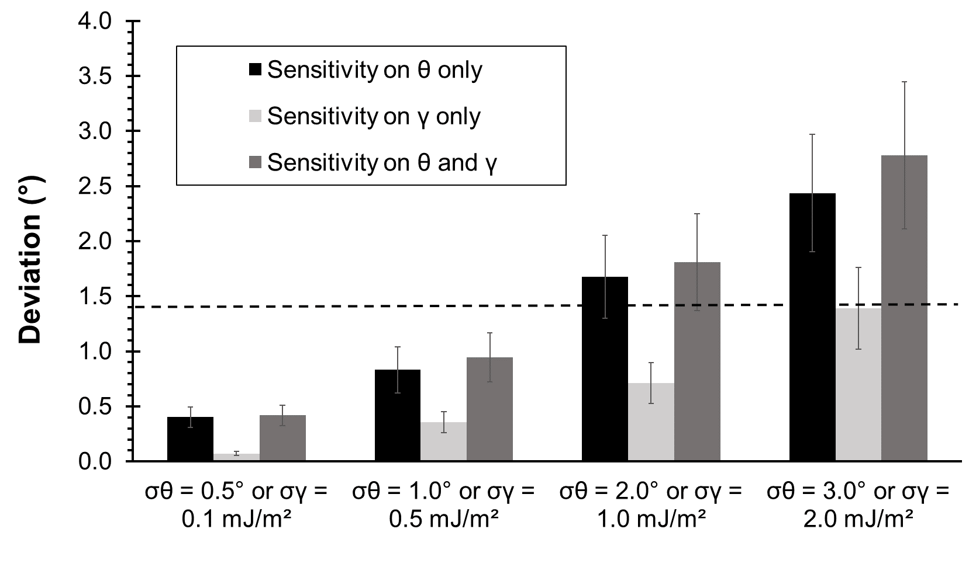
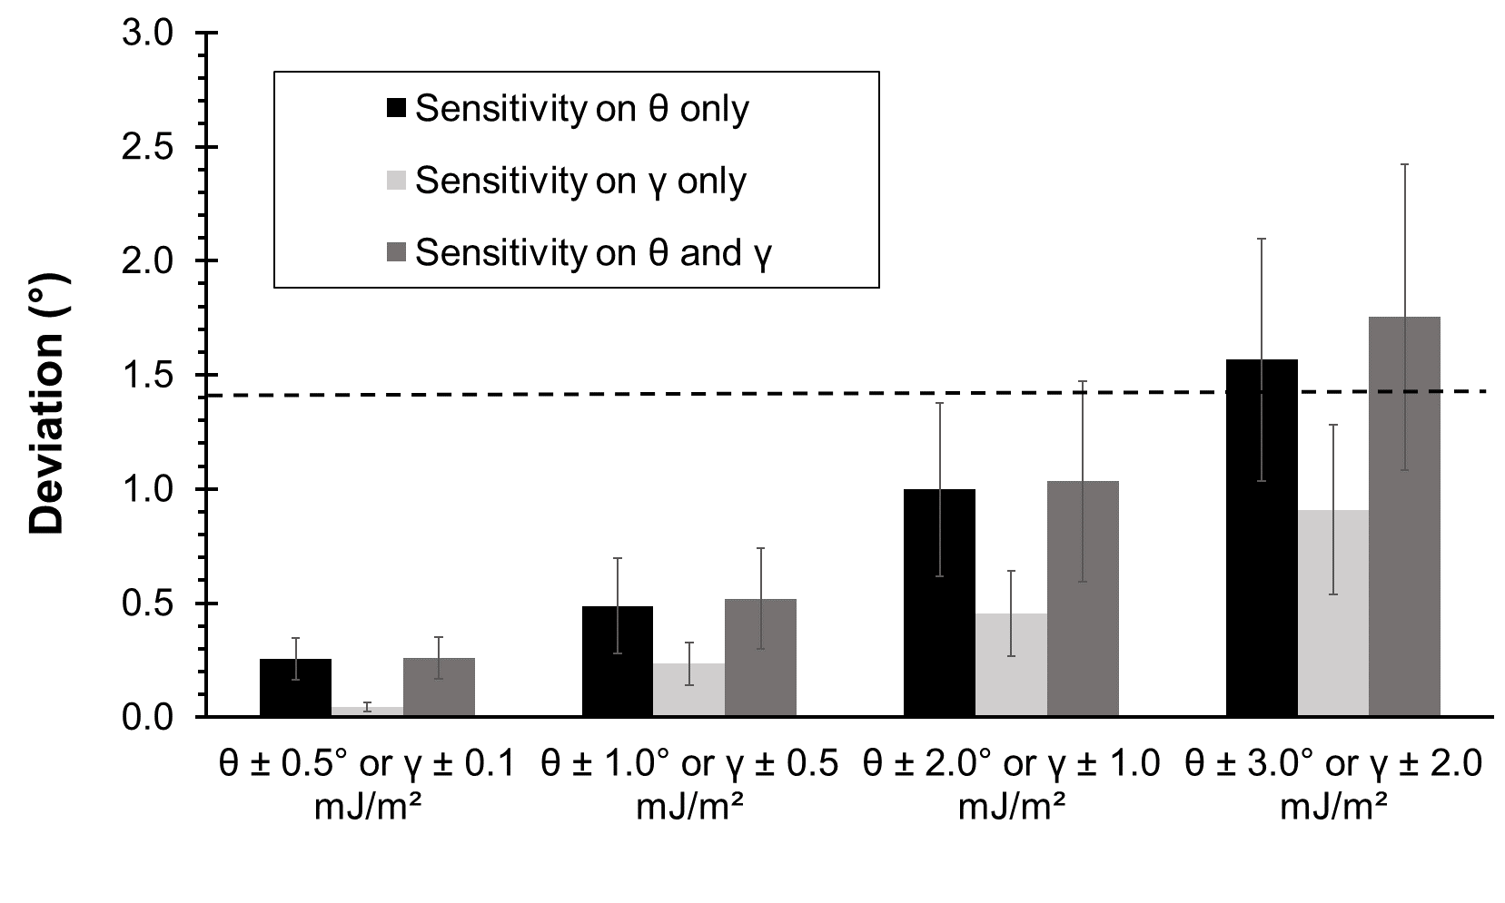
Sensitivity analysis: Deviation of the contact angle between simulated values and the “ideal” predicted values
The simulated values were distributed according to a normal distribution with standard deviations σθ and σγ. The simulation was performed in the case of glycerol on steel (f = 1.38 and <d> = 4.66 Å). The dotted line shows the deviation between our experiment and the ideal case.
Random noise fluctuations around the average values and between lower and upper bounds (“experimental cutoff”).
Duchemin, 2021

Slide 31
Sensitivity analysis: Deviation of the contact angle between simulated values and the “ideal” predicted values
Predictions with a standard error less than 2°.
The simulated values were distributed according to a normal distribution with standard deviations σθ and σγ. The simulation was performed in the case of glycerol on steel (f = 1.38 and <d> = 4.66 Å). The dotted line shows the deviation between our experiment and the ideal case.
Random noise fluctuations around the average values and between lower and upper bounds (“experimental cutoff”).
Duchemin, 2021

Slide 32
Conclusions
Predicting contact angle variations with temperature cannot be performed using the partitioning theory.
A novel physical model is proposed centered around the extension of thermocapillary vibrations near the interface.
The model is based on scaling arguments.
The model encompasses normal wetting, Cassie-Baxter and Wenzel states, and the transition to total wetting.
Temperature variations can be useful to yield two comprehensive parameters: f and <d>
The novel model appears to predict meaningful contact angles with experimentally realistic noise levels: sensitivity analysis showed that standard deviations σ_{θ} = 2° and σ_{γ} = 1 mJ/m² would still produce predicted angles with a standard error less than 2°.
Duchemin, 2021

Slide 33



Thank you for your attention
LAB
TRANSAT JACQUES VABRE (www.scanvoile.com)
THANKS to funding agency: French National Research Agency (grant number ANR-11-RMNP-0020)
Duchemin, B., Cazaux, G., Gomina, M., Bréard, J., 2021. Temperature-dependence of the static contact angle: A transition state theory approach. Journal of Colloid and Interface Science 592, 215–226. (Preprint on HAL.)
PAPER ID: 3550191 The potential of nanocelluloses in microfluidics: Optofluidics, liquid marbles and disposable chips”
[CELL] SESSION: Advances in Renewable Materials ; DATE: April 14, 2021; PRESENTATION TIME: 3:30 PM to 3:55 PM
Duchemin, 2021

