Slide 1








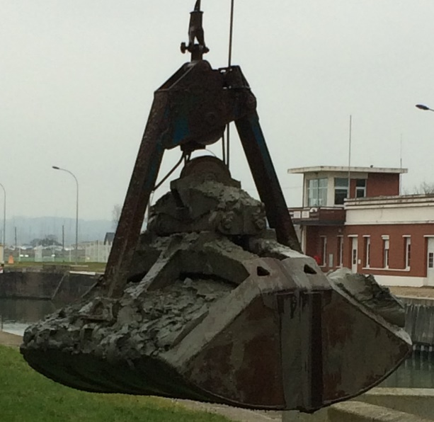
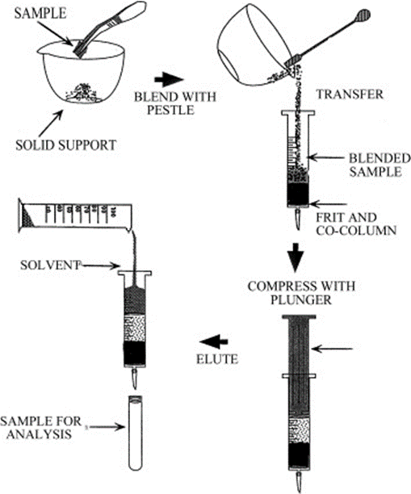
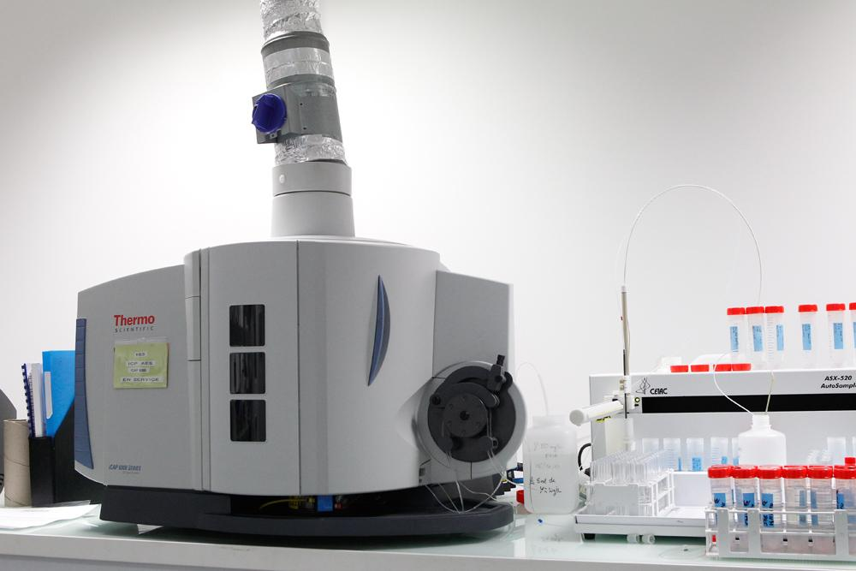

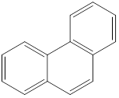
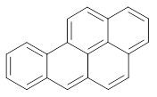
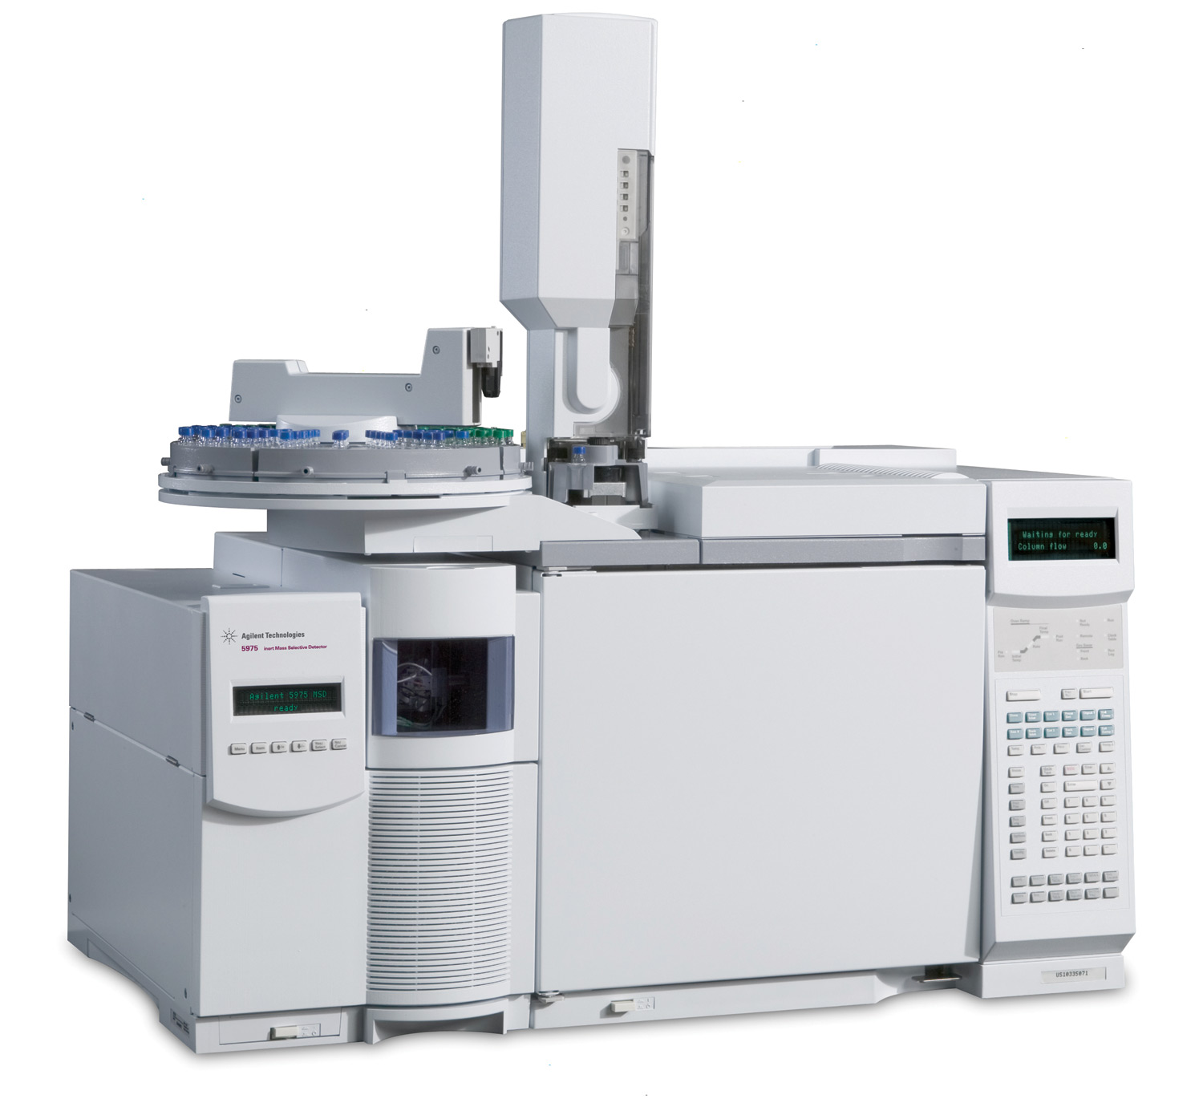
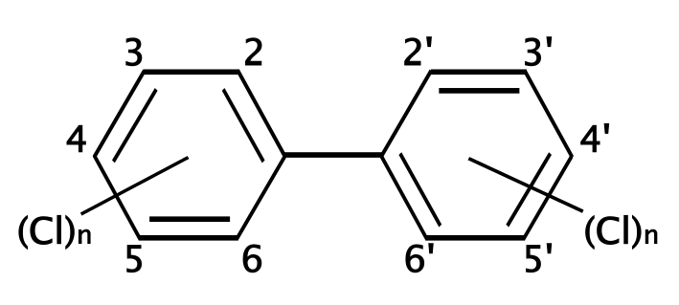
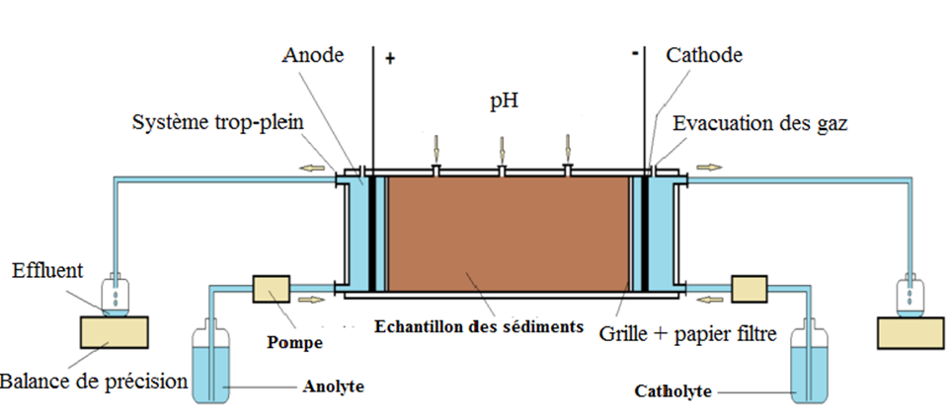
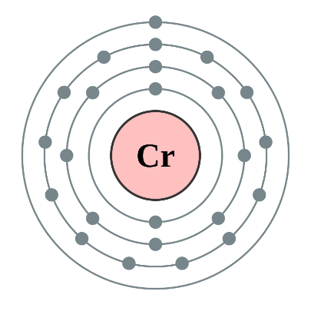
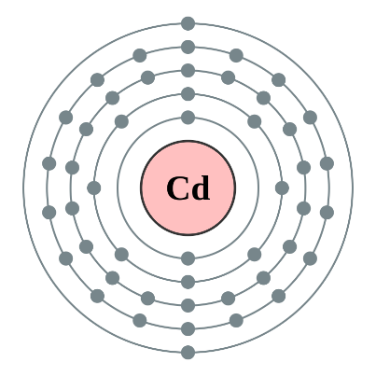
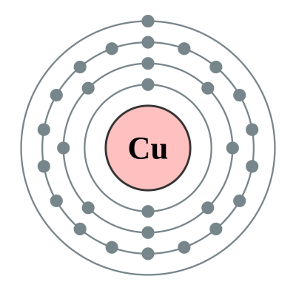
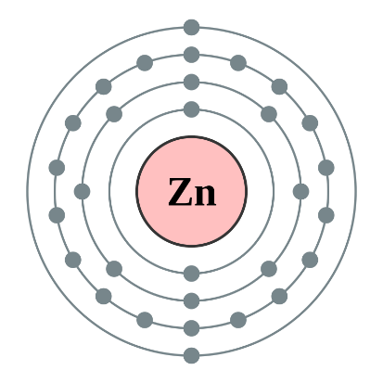
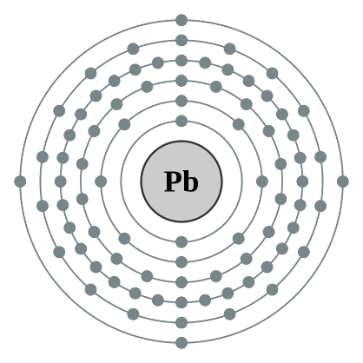
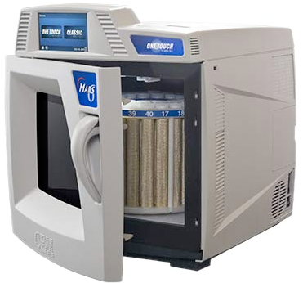
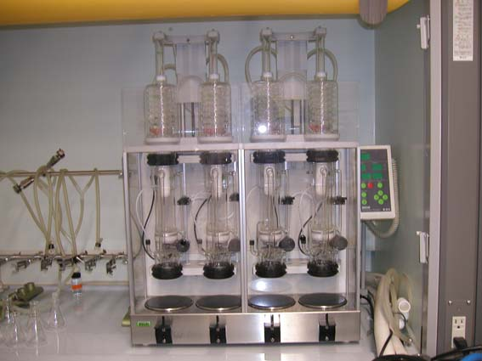
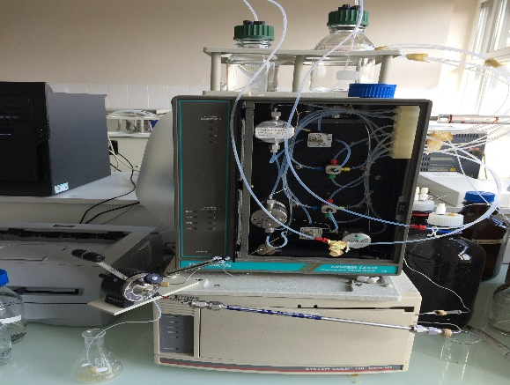
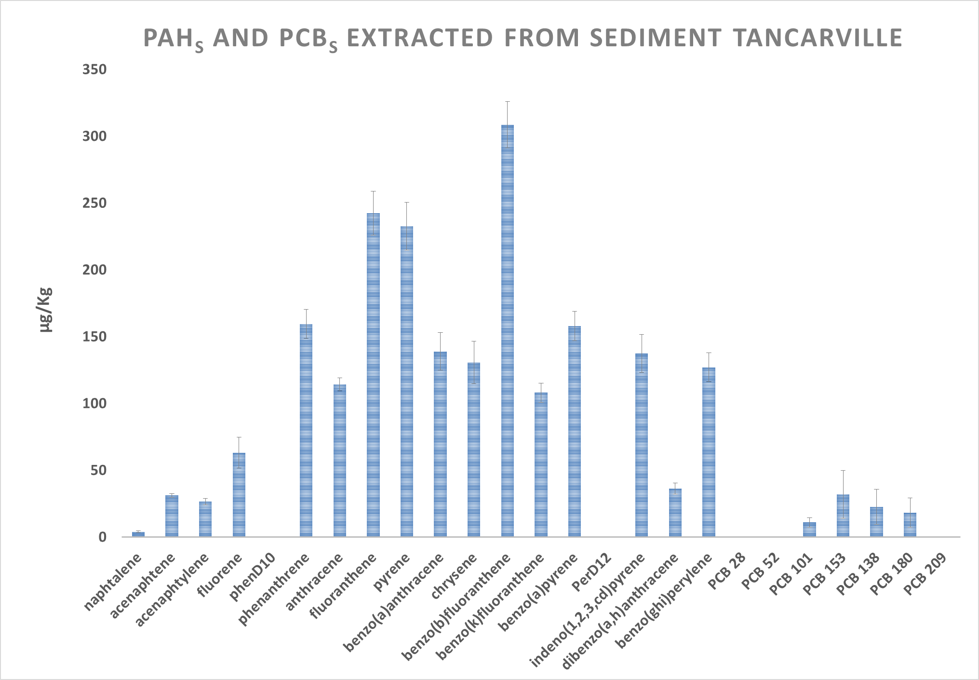
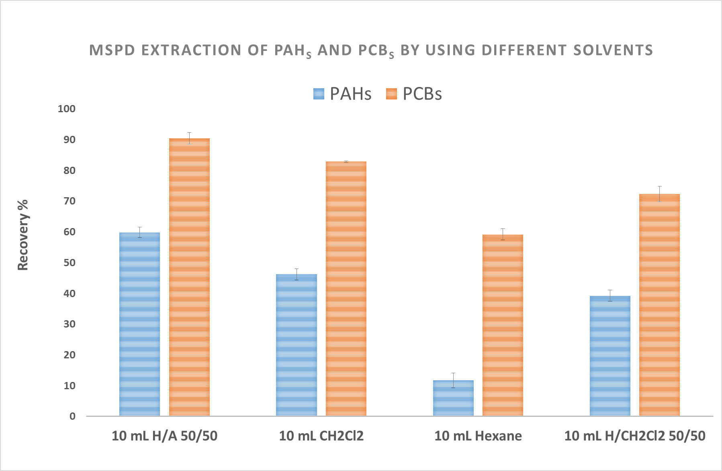
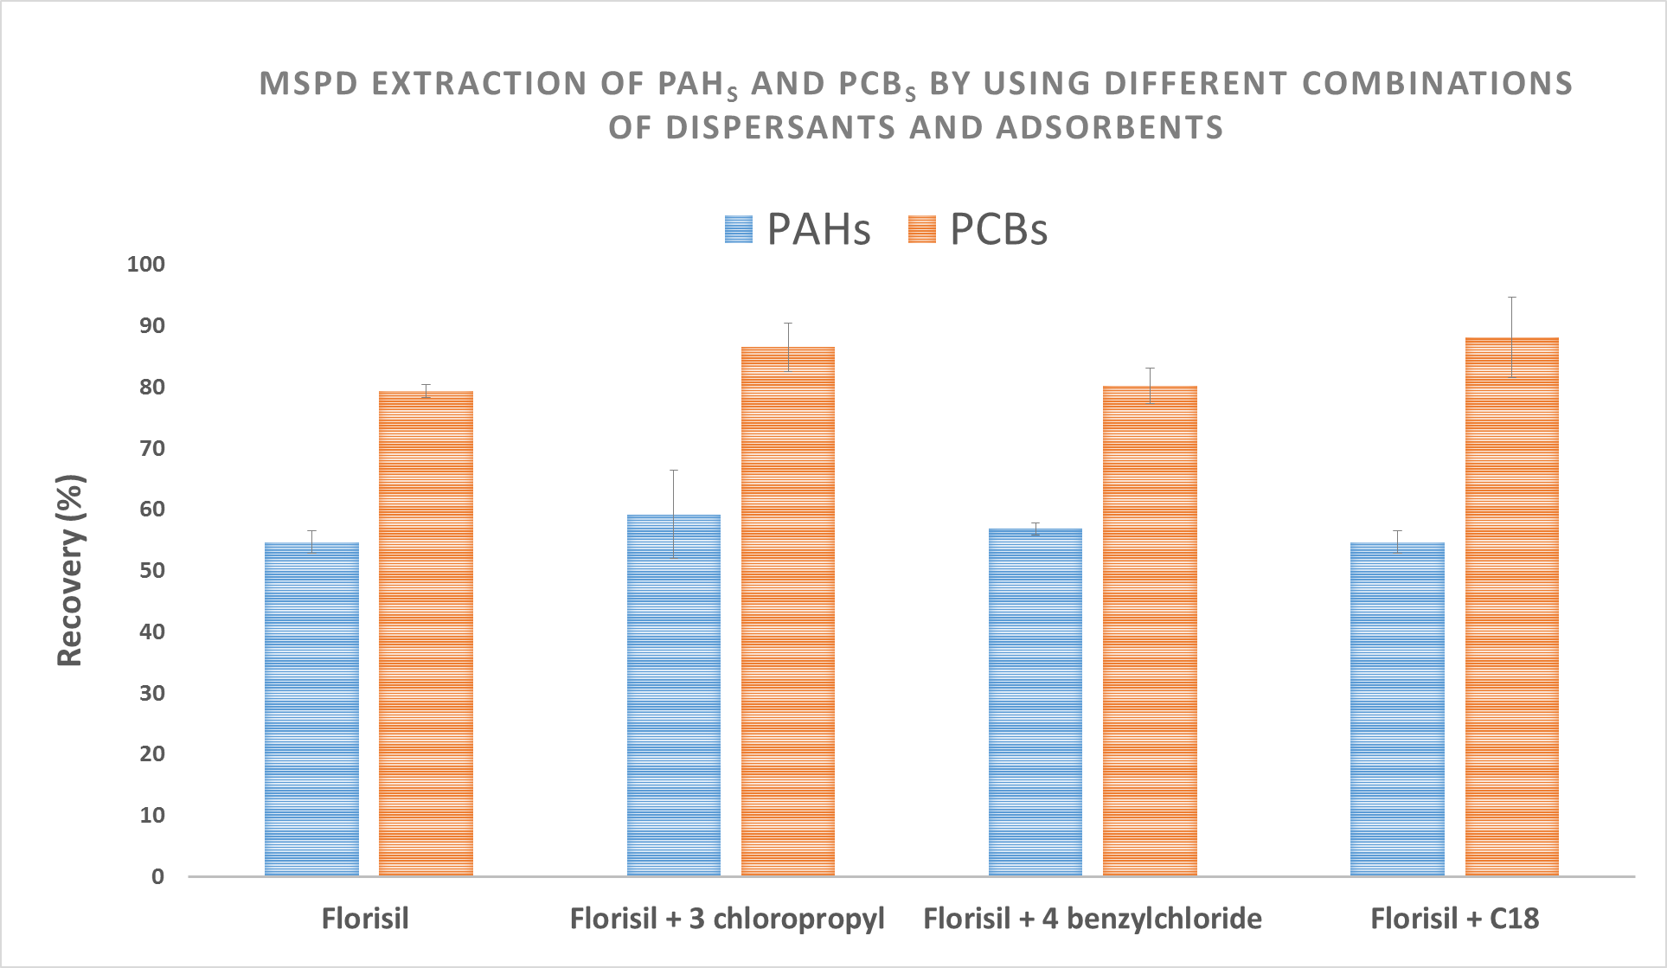
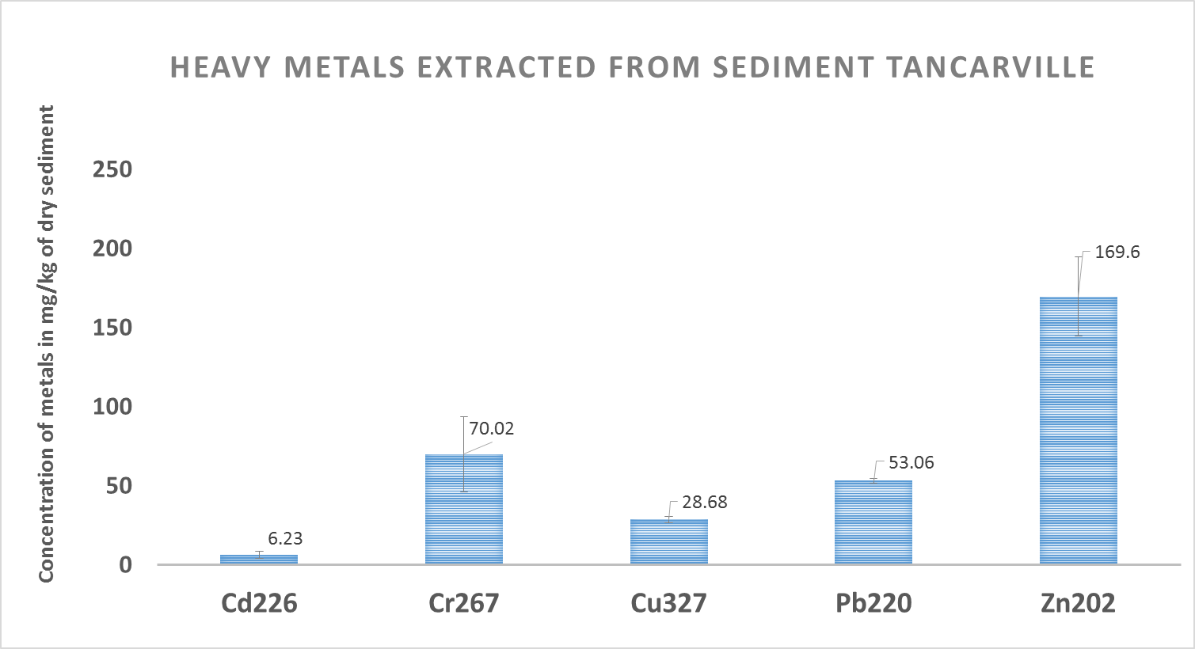
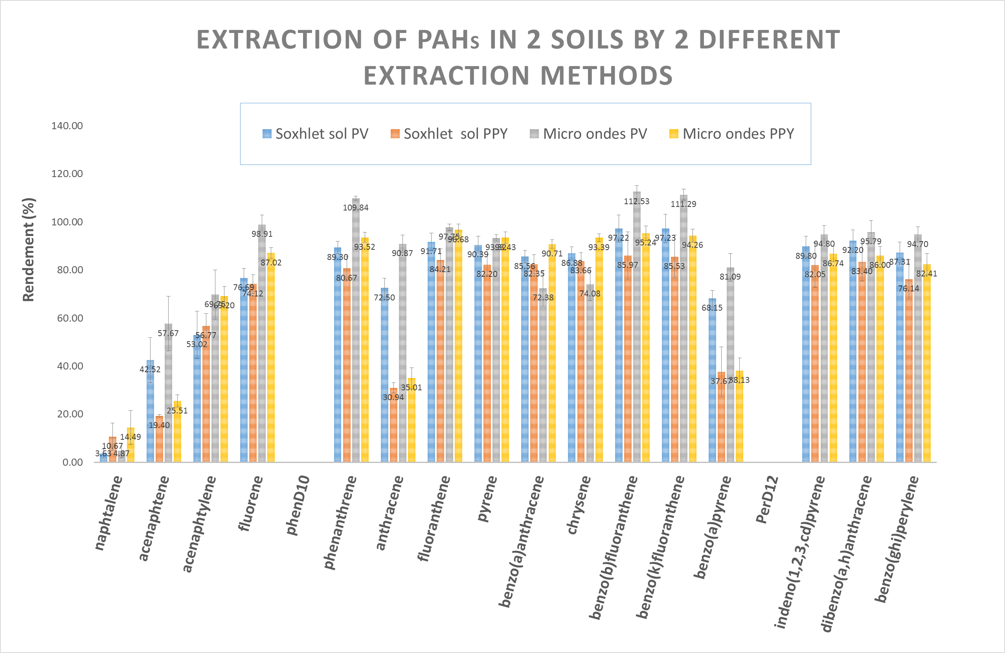
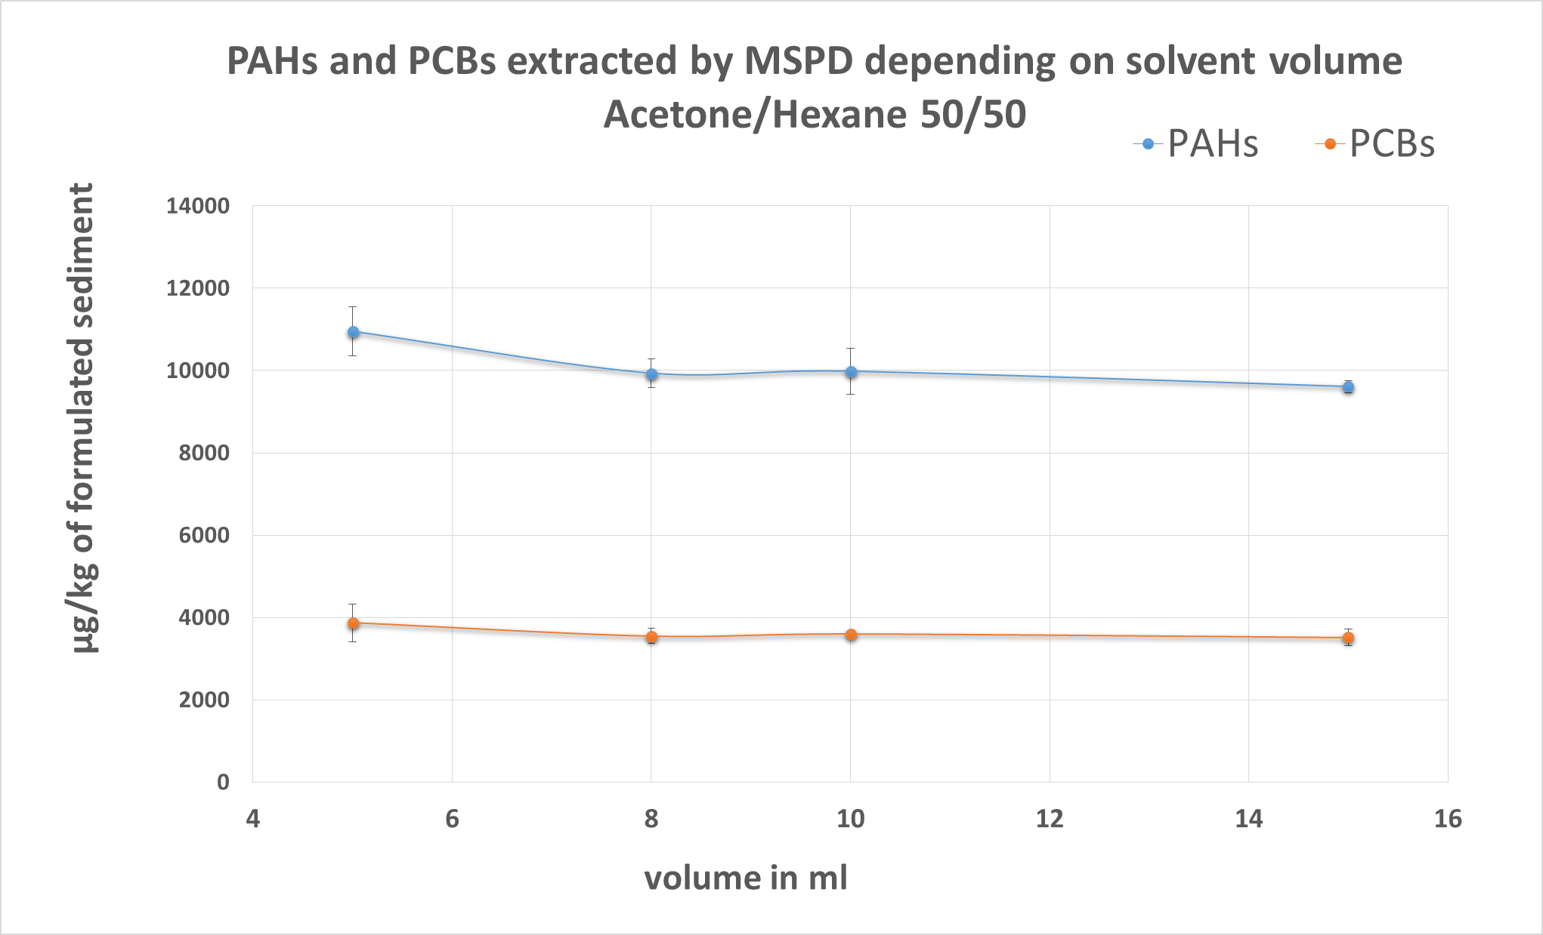
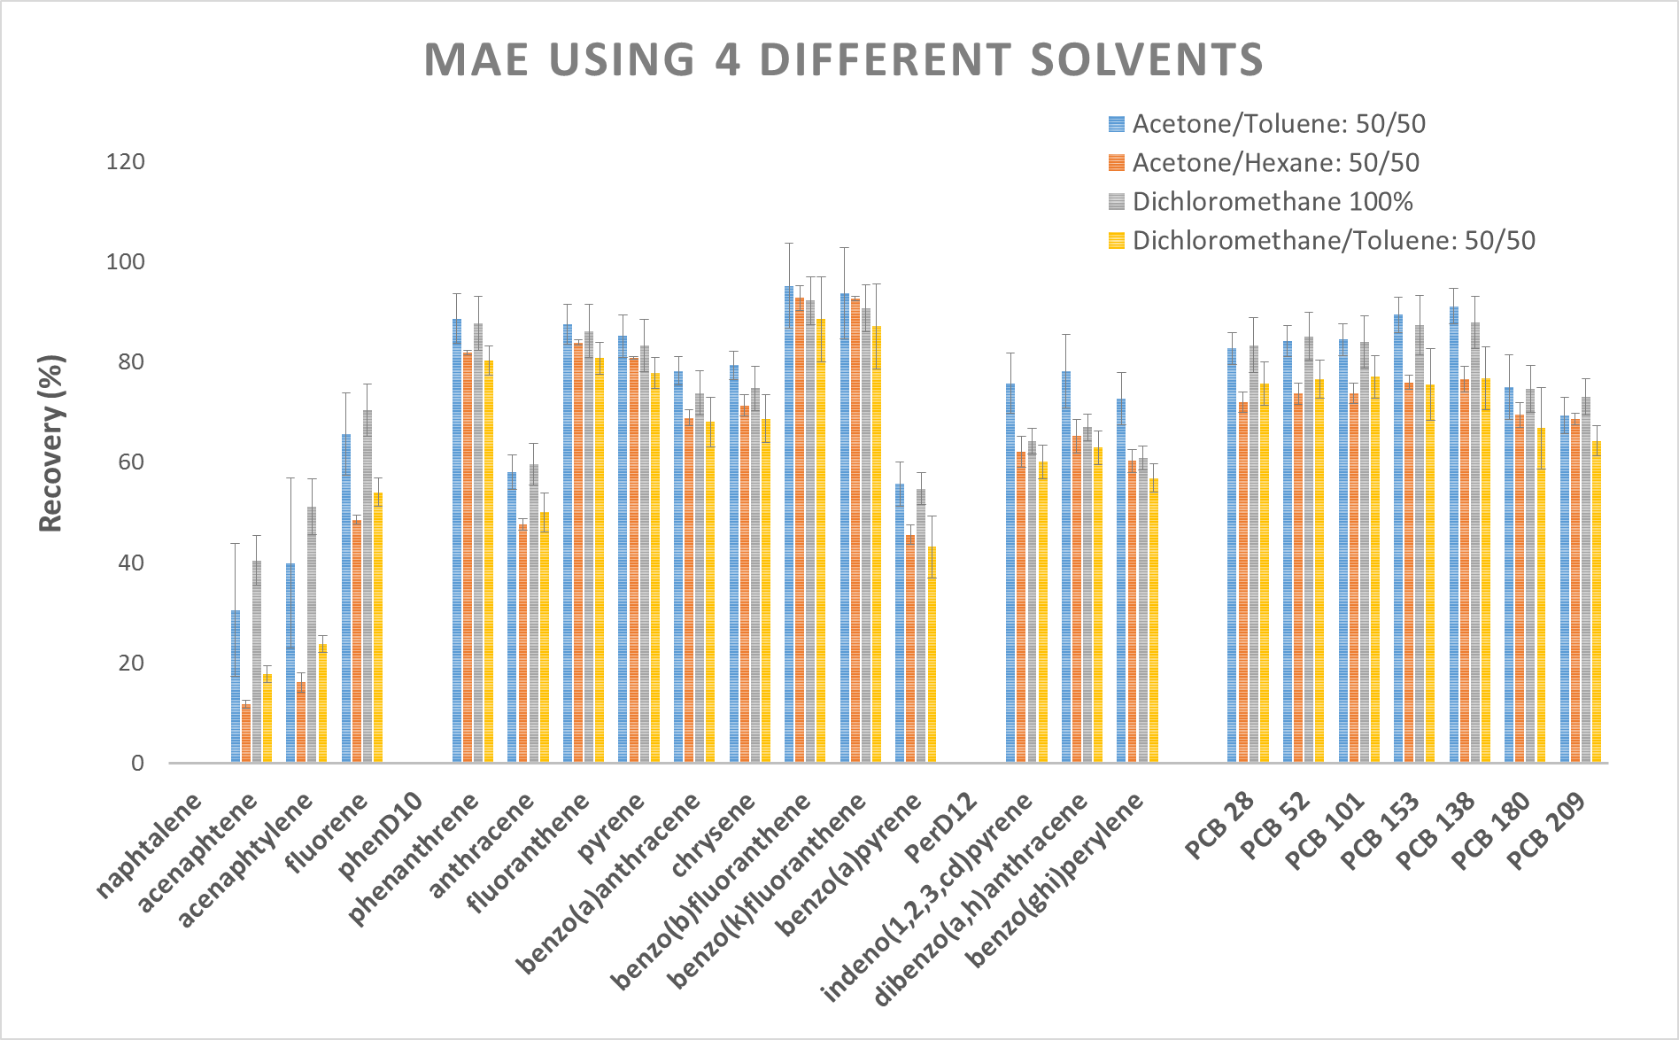
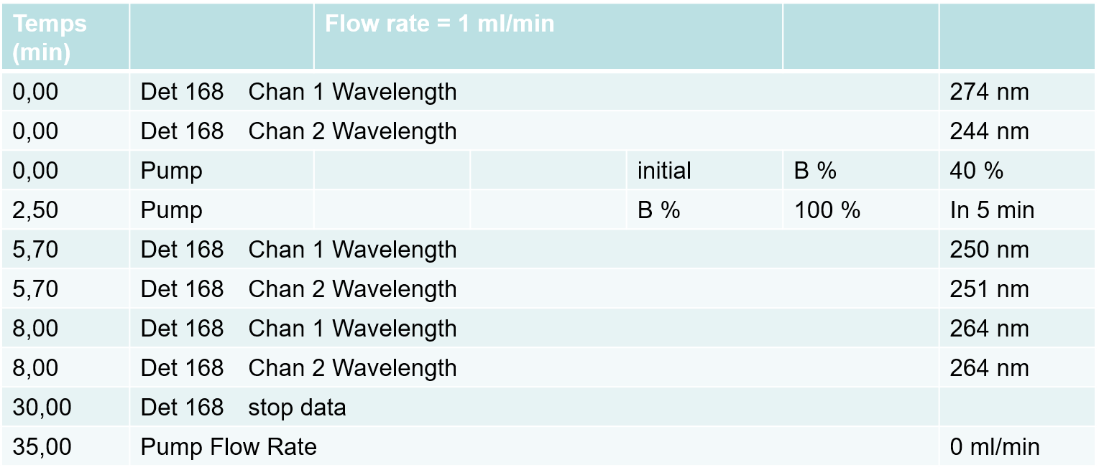
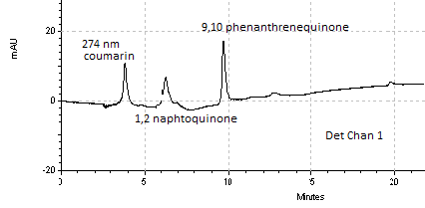
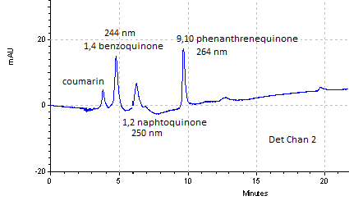
Development of analytical methods for the analysis of contaminants in sediment after electro-kinetic treatment
Y. Tian^{1,2}, A. Benamar², C. Boulangé-Lecomte³, F. Portet-Koltalo¹
1 Laboratoire COBRA UMR CNRS 6014, Université de Rouen, 55 rue Saint Germain, 27000 Evreux. 2 Laboratoire LOMC UMR CNRS 6294, Université du Havre, 53 rue Prony, 76058 le Havre. 3 Laboratoire SEBIO UMR I02, Université du Havre, 25 rue Philippe Lebon, CS 80540, 76058 Le Havre
Introduction
Materials & Methods
Many organic pollutants such as PAHs and PCBs and metal contaminants are accumulated in the sediment
Consequences:
  Damaging aquatic ecosystems
  Toxic for life including human-beings
Aims of researches:
  Develop extraction and analytical methods for these pollutants and their metabolites
  Using electro-kinetic (EK) method for reducing their quantities in sediment
  Organic pollutants:
    16 polycyclic aromatic hydrocarbons (PAHs)
    2 rings 3 rings … 5 rings
    naphthalene phenanthrene benzo[a]pyrene
    7 Polychlorinated biphenyls (PCBs)
  Inorganics: metal contaminants
Harbor dredged sediments
Extraction methods
Analytic methods
ICP-AES for metals
MSPD
MSPD
GC-MS for PAHs and PCBs
Electro-kinetic treatment
MAE Microwaves
Soxhlet
HPLC-Flu/UV for metabolites
Results and discussions
GC-MS analysis of PAHs and PCBs
Extraction of real sediment pollutants from Tancarville
MSPD: matrix solid phase dispersive extraction
Hexane/Acetone
Extraction of soil organic pollutants
Acenaphtalene, fluorene and anthracene > N1 GEODE (< N2), other PAHs < N1.
PCBs < N1.
Metals < N1, but Cd > N2.
Hexane/Acetone 50/50: more efficient
Recovery of PAHs 60% (<71,4% with MAE) and PCBs 90% (>84.5 with MAE).
Effect of solvent volume and combinations of dispersants = not significant
MSPD: simpler and faster than MAE
HPLC-UV analysis for PAH quinones
MAE (microwave) is more efficient and faster than the traditional Soxhlet method.
Acetone/Toluene or CH₂Cl₂ = good extracting solvents for PAHs+PCBs
4 PAH quinones are separated by C18 RP column.
Resolution is good enough.
Problem: UV detection not enough selective (pics may coincide with other substances)
Conclusion
Perspectives
GC-MS and ICP-AES are adapted to detect different pollutant families in sediment.
Extraction efficiency: MSPD > MAE > Soxhlet.
⇨ MSPD still needs optimization (necessary to introduce surrogate standards to correct results related to poor reproducibility of flow-rates).
HPLC-UV not enough selective to analyse PAHs metabolites
⇨ Coupling UV+fluorescence ? GC-MS after derivatization?
Improving EK treatments using original additive mixtures: biosurfactants + citric acid
Detect PAH metabolites (quinones + hydroxyl-) and reduced PCBs after EK treatment ⇨ link with sediment toxicity?
Microcosms tests to monitor natural dissipation of contaminants in Tancarville sediment (comparison with EK treatment efficiency)

